Slide 1

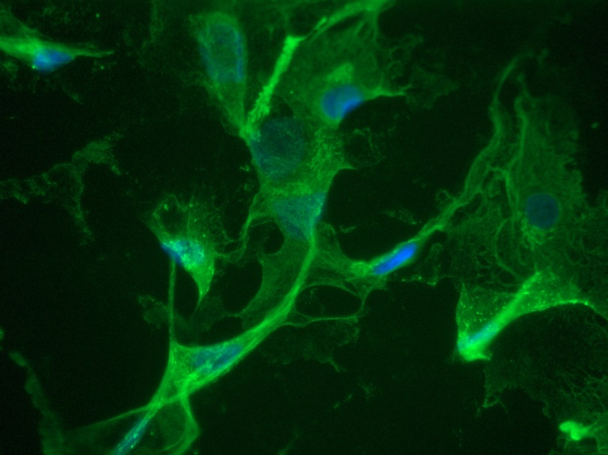
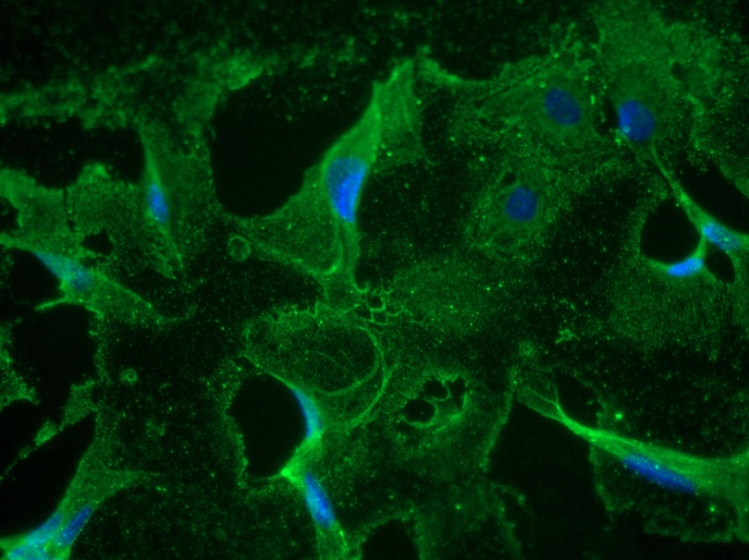
Reliatech GmbH
Mouse anti-human VEGFR-2/KDR
(Cat# 101-M34; 101-M22)
KDR: #101-M34 (10µg/ml)
KDR #101-M22 (10µg/ml)
Immunofluorescence staining of human VEGFR-2/KDR in primary human umbilical vein endothelial cells (HUVEC) using a monoclonal mouse anti-human KDR antibody. As secondary antibody goat anti-mouse ALEXA Flour 488 (Dianova) was used 1:800. [IF_HU1402-08]
.
http://www.reliatech.de / orders@reliatech.de

